Slide 2
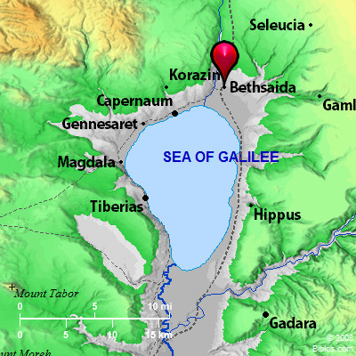
Circa 1 B.C.
Galilean named Jonah
Had a son named Simon

Slide 3
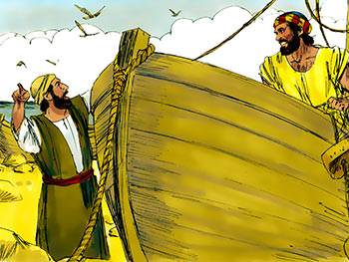
Was a fisherman by trade
Rough and rugged individual

Slide 4
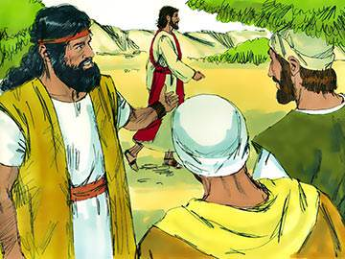
His Brother Andrew, a follower of John, introduced Simon to Jesus – John 1:40,41

Slide 5
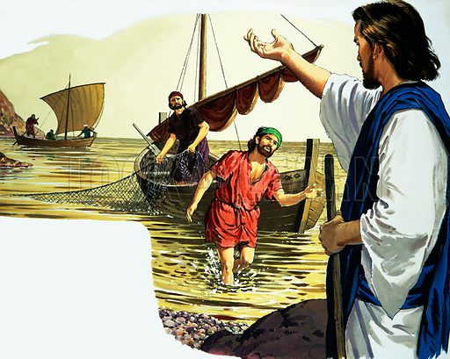
Simon Peter called to follow Jesus as he fished – Matthew 4:18-20

Slide 6
Peter took the lead many times
Jesus’ hard sayings caused many to depart from Him – John 6:67,68
He was FIRST to confess Jesus as the Christ – Matthew 16:13-18
His sermon was recorded by Luke of Pentecost- Acts 2:14
We read much about the work of Peter in the book of Acts

Slide 7
THE FALL AND RISE OF PETER

Slide 8
Peter Was Over-confident
Mark 14:29 “Even if ALL are made to stumble, yet I will not be.”
Foolish for a man to trust in his OWN STRENGTH – Jeremiah 17:5
1 Corinthians 9:27; 10:12
Too much SELF CONFIDENCE was a step In the FALL OF PETER!

Slide 9
Peter Made Some Hasty Promises
Mark 14:31 “If I have to dies with You, I will not deny You!”
John 13:33,36,37
Need to COUNT THE COST!
Matthew 16:24 “let him deny himself, take up his cross, and follow Me.”
Luke 9:57-62 – Never want to look back

Slide 10
Peter Dropped His Guard
Mark 14:37 “Simon, are you sleeping? Could you not watch one hour?”
No REAL danger
Just fall asleep like the others!
Being aroused out of sleep- rash action
John 18:10,11 “cut off his right ear…”
Matthew 26:52 “all who take the sword will perish by the sword.”

Slide 11
Peter Denied His Lord
Matthew 26:58 “followed Him at a distance”
Not close enough to be identified as one of His followers!
Whenever it was POPULAR- forefront!
NOT so popular – keeping his distance!
John 18:18 “Peter stood with them and warmed himself.”

Slide 12
Peter Denied His Lord
Begins to CURSE – Matthew 26:69-72
“You also were with Jesus” “I do not know what you are saying”
This fellow also was with Jesus” “denied with an oath, I do not know the Man!”
Matthew 26:73,74 – “Surely you also are one of them” “he began to curse and swear, saying, I do not know the Man!”

Slide 13
The Rise Of Peter
He remembered what the Lord said to him – Mark 14:72 “And when he thought about it, he wept."
2 Corinthians 7:9,10 “godly sorrow produces repentance”
He was NOW on his way BACK!
1 Peter 5:6 "Therefore humble yourselves under the mighty hand of God, that He may exalt you in due time."

Slide 14
What Can We Learn From This?
Peter’s steps can be retraced TODAY!
We TOO can fall!
Galatians 5:4 “…become estranged from Christ… fall from grace.”
2 Peter 2:20,21 “it would have been better for them not to have known the way of righteousness, than having known it, to turn from the holy commandment delivered to them”

Slide 15
What Can We Learn From This?
We dare not be overconfident as was Peter
Must not make hasty promises
Must not drop our guard
1 Peter 5:8
Must NEVER, NEVER DENY CHRIST!
Matthew 10:32,33
IF we have FALLEN, we can RISE AGAIN
Revelation 2:5 – REMEMBER where we were before – DO THE FIRST WORKS!

